Slide 1


ATLIQ HARDWARE –AD HOC INSIGHTS CONSUMER GOODS
Presented By –Sanchita Dasgupta

Slide 2
Contents
Company overview
Problem Statement
Data Requests & Tools
Analysis on the Ad-Hoc Requests & Insights
Conclusion.

Slide 3
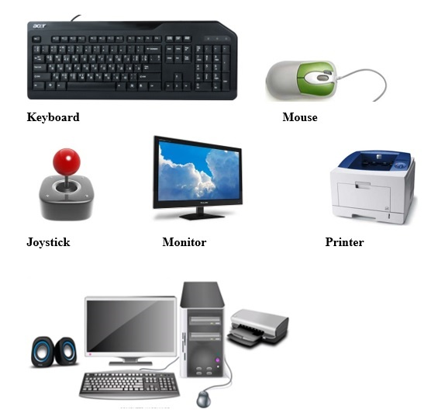
Company Overview [Atliq Hardware]
Atliq Hardware's, a prominent computer hardware manufacturer in India, has established a strong presence in international markets. The company operates on a fiscal year calendar running from September to August, where FY 2020 corresponds to September 2019 to August 2020, and FY 2021 spans September 2020 to August 2021.

Slide 4





Company Overview [Atliq Hardware]
CONSUMER
ATLIQ HARDWARE
CUSTOMER

Slide 5
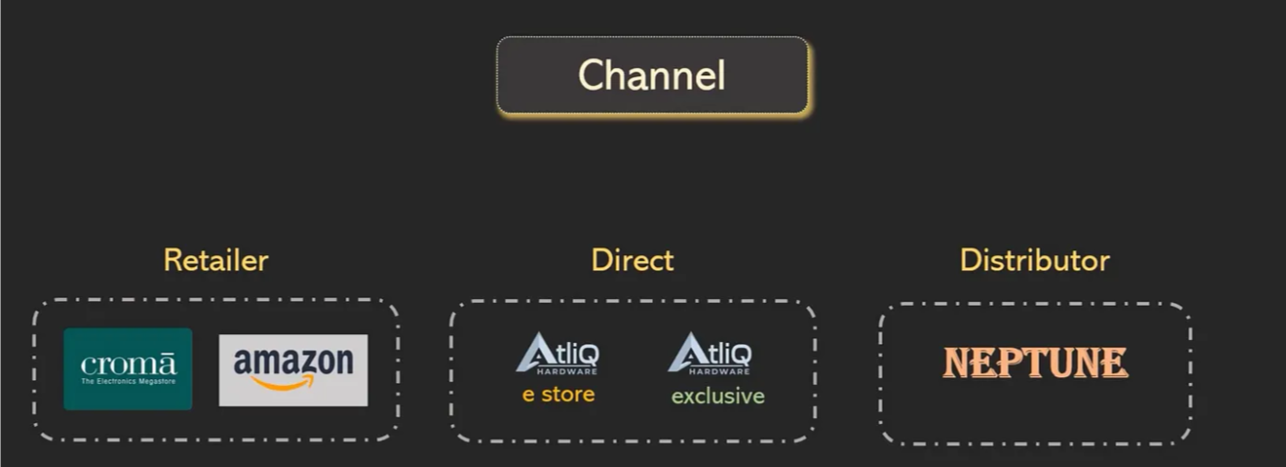
Company Overview [Atliq Hardware]

Slide 6


Problem Statement
Despite Atliq Hardware's success, management has identified a critical gap in actionable insights, which limits their ability to make prompt, data-driven decisions. To bridge this gap, they aim to enhance their data analytics capabilities by expanding the team with skilled junior data analysts. To ensure the right talent is onboarded, they designed a targeted SQL challenge to effectively evaluate the analytical and technical proficiency of potential candidates.

Slide 7

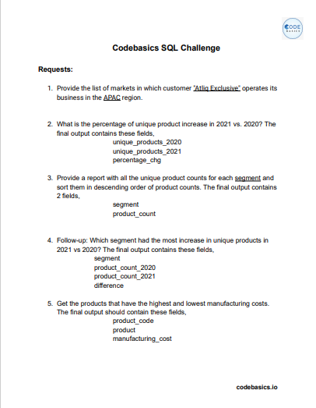
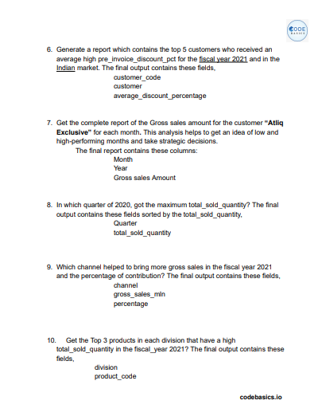
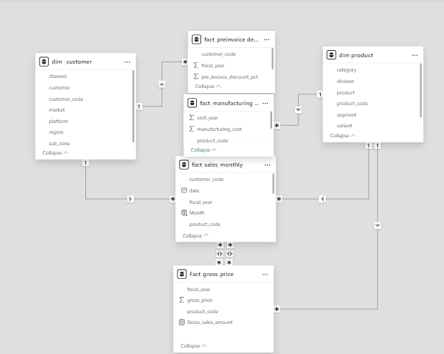
Data Requests and tools

Slide 8

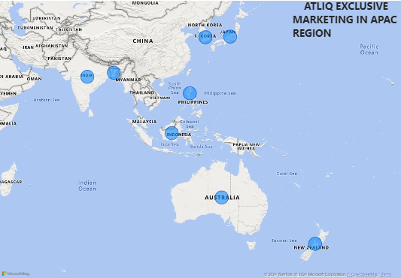
Analysis on the Ad-Hoc Requests & Insights
Provide the list of markets in which customer "Atliq Exclusive" operates its business in the APAC region.

Slide 9
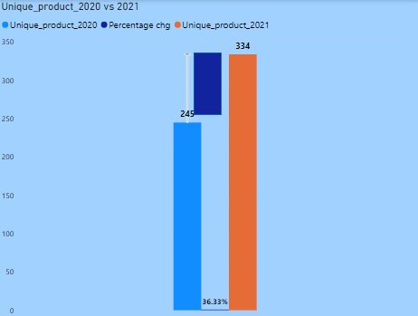
2. What is the percentage of unique product increase in 2021 vs. 2020? The final output contains these fields, unique_products_2020 unique_products_2021 percentage change
INSIGHTS: Both demand and production have experienced an increase, suggesting a positive trend in customer interest and a corresponding boost in manufacturing capacity to meet this growing demand

Slide 10
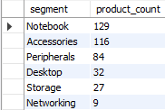
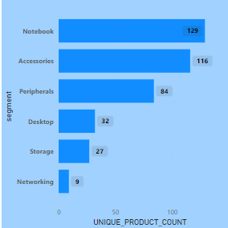
3. Provide a report with all the unique product counts for each segment and sort them in descending order of product counts. The final output contains 2 fields, segment product count
INSIGHTS:The data reveals that Notebooks and Accessories account for approximately 83% of the total product count, indicating their dominant role in the product lineup. In contrast, categories like Desktops, Storage, and Networking make up only 16% of the product count, highlighting a more limited contribution to the overall inventory.

Slide 11
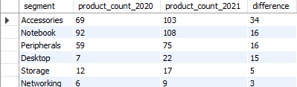
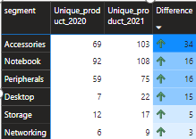
4. Follow-up: Which segment had the most increase in unique products in 2021 vs 2020? The final output contains these fields, segment product_count_2020 product_count_2021 difference
INSIGHTS: Accessories is the largest growth in product increase of 38% from previous year and the networking is lowest increasing the production growth

Slide 12
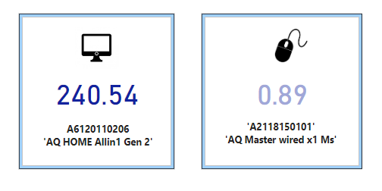

5.Get the products that have the highest and lowest manufacturing costs. The final output should contain these fields, product code product manufacturing cost
INSIGHTS: The highest manufacturing cost is associated with the Personal Laptop: AQ Home Allin1Gen2, indicating that it likely involves more complex components or advanced technology. On the other hand, the lowest manufacturing cost is for the Mouse: AQ Master Wired X1Ms, reflecting its simpler design and production requirements.

Slide 13
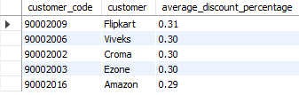
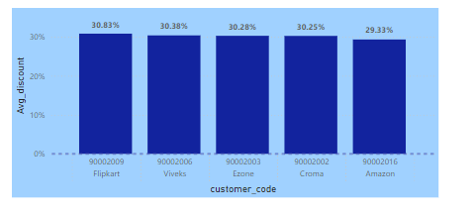
6.Generate a report which contains the top 5 customers who received an average high pre_invoice_discount_pct for the fiscal year 2021 and in the Indian market. The final output contains these fields, customer code customer average-discount-percentage
INSIGHTS :Flipkart offers the highest discount percentage among the compared platforms, while Amazon provides the lowest discount percentage.

Slide 14
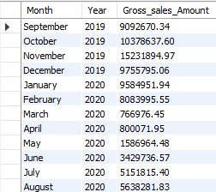
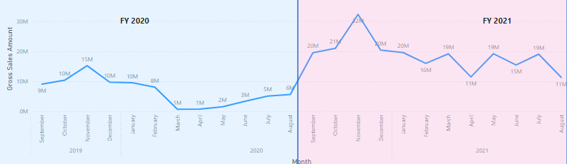
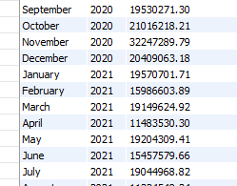
7.Get the complete report of the Gross sales amount for the customer “Atliq Exclusive” for each month. This analysis helps to get an idea of low and high-performing months and take strategic decisions. The final report contains these columns: Month Year Gross sales Amount
Highest gross sales amount
Lowest gross sales amount
INSIGHTS: The highest gross sales were recorded in November 2021, while the lowest gross sales occurred in March 2020. This disparity can be attributed to the global economic shock caused by COVID-19, which significantly impacted consumer behavior and business operations during early 2020.

Slide 15

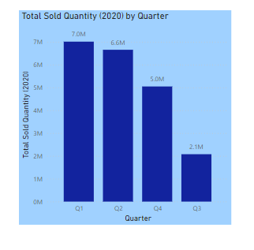
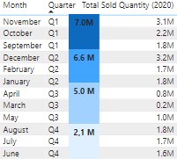
8.In which quarter of 2020, got the maximum total-sold-quantity? The final output contains these fields sorted by the total-sold-quantity, Quarter ,total-sold-quantity
INSIGHTS- Quarter 1 records the highest sales, while Quarter 3 has the lowest sales, contributing 34% of the total. Among the months, December has the highest sales volume, whereas March has the lowest.

Slide 16

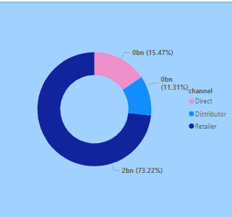
9.Which channel helped to bring more gross sales in the fiscal year 2021 and the percentage of contribution? The final output contains these fields, channel gross-sales-Million percentage
INSIGHTS: The Retailers channel contributes the highest share of gross sales at 73.2%, while the Distributors channel accounts for the lowest share at 11.31%, highlighting a significant disparity in sales performance across channels.

Slide 17
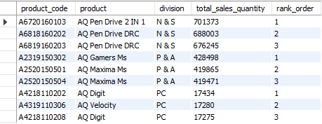
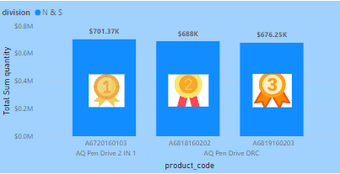
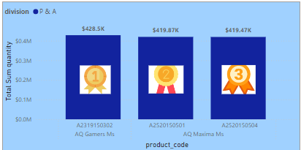
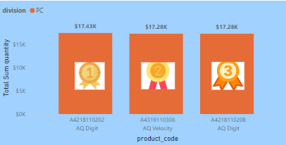
10.Get the Top 3 products in each division that have a high total-sold-quantity in the fiscal year 2021? The final output contains these fields, division product-code

Slide 18
Conclusion
Optimize Product Strategy: Focus resources on high-demand segments like Notebooks and Accessories, while identifying niche opportunities in less dominant categories.
Maximize Sales Channels: Strengthen retailer partnerships, contributing the largest revenue share, and innovate strategies to uplift distributor performance.
Strategic Pricing Insights: Adjust discount strategies using data to stay competitive while protecting profits. Take inspiration from Amazon’s effective approach to offering lower discounts.
Leverage High-Performing Periods: Align campaigns and supply chain readiness to capitalize on peak sales months, especially November and Q1.

Slide 19
Thank You

